Slide 1


UNIT 2: Time for action
Unit 2 – Roundup & Writing rules 2

Slide 2
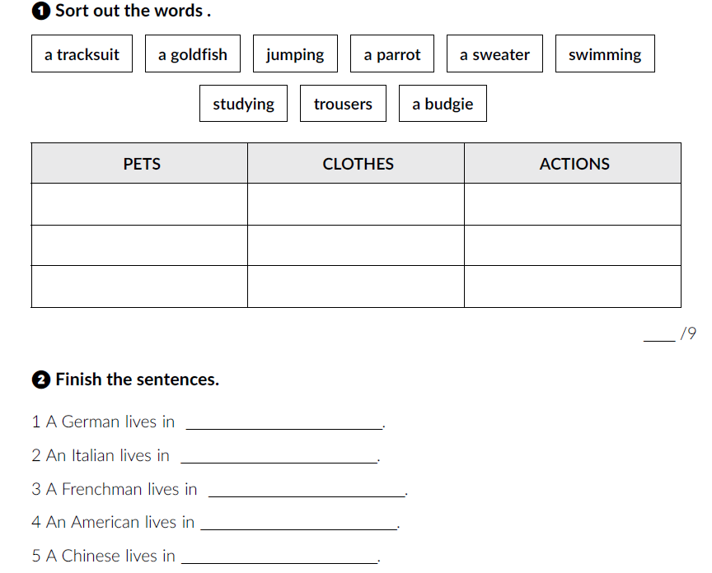
workbook p. 29/30.
a goldfish
a tracksuit
jumping
a parrot
a sweater
swimming
a budgie
trousers
studying
Germany
Italy
France
the USA
China

Slide 3
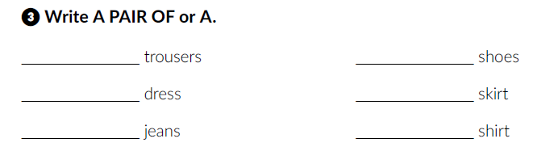
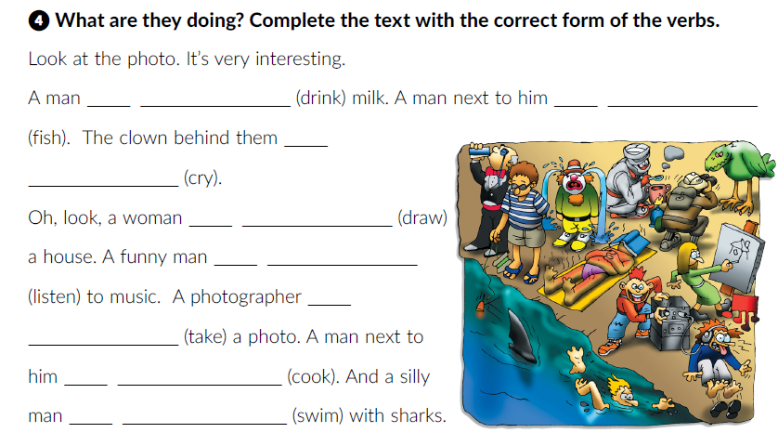
a pair of
a pair of
a
a
a pair of
a
is drinking
is fishing
is
crying
is drawing
is listening
is
taking
is cooking
is swimming

Slide 4
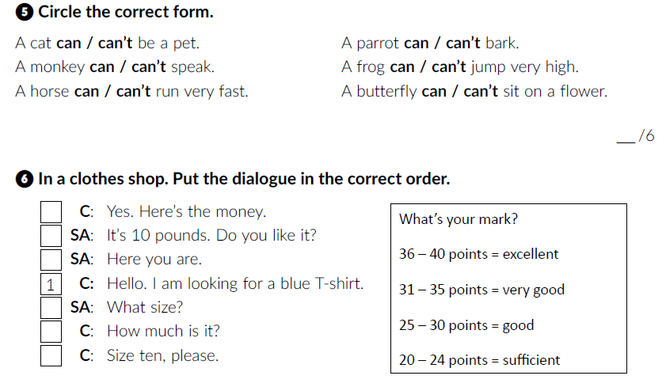
7
6
4
2
5
3

Slide 5
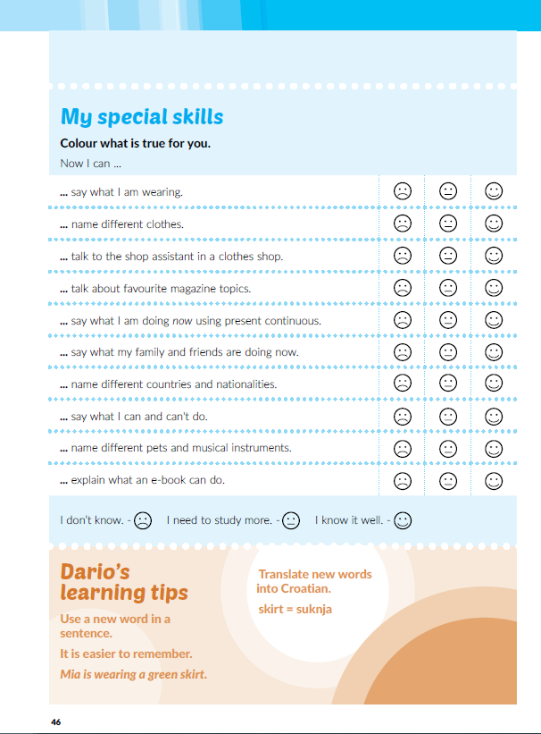
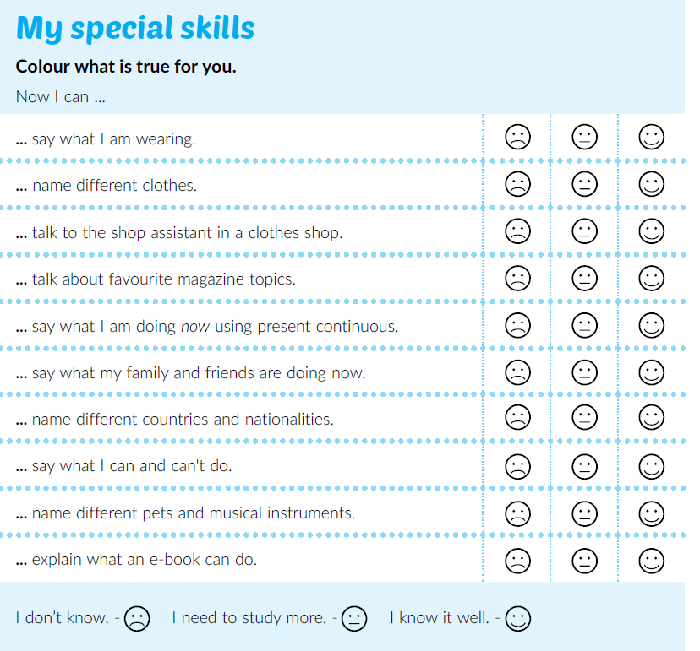
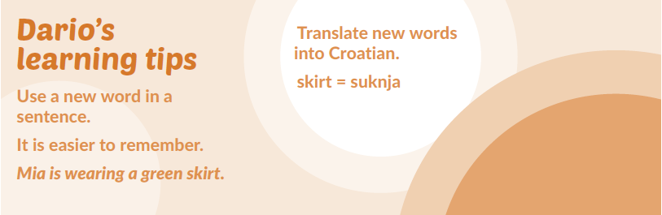
Open your book at page 46.
Read Dario’s learning tips.

Slide 6
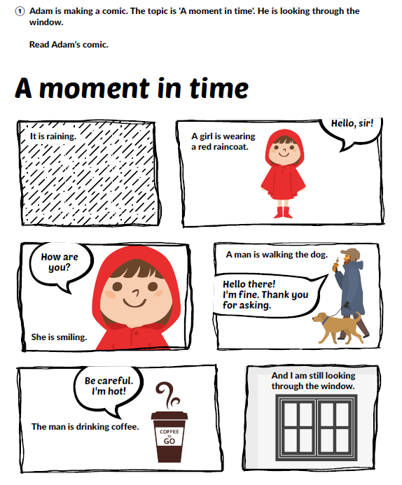
Do you like comics?
What is your favourite?
Do you know any films based on comics?
Read the comic at page 44.
What is Adam doing?
What’s the weather like?
What is the girl wearing?
Who is walking the dog?
What does the coffee cup say?

Slide 7
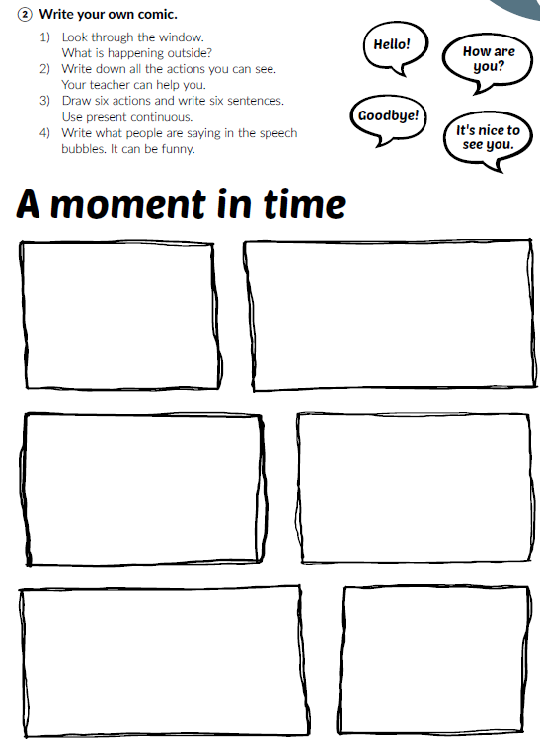

Read the instructions and write your own comic.

